Slide 1
Windows 10 Module 2
Understanding File Management

Slide 2
Module Objectives
Understand files and folders
Create and save a file
Explore the files and folders on your computer
Change file and folder views
Open, edit, and save files
Copy files
Move and rename files
Search for files and folders
Delete and restore files

Slide 3
Understand Files and Folders (Slide 1 of 3)
File Hierarchy is a system that arranges files and folders in different levels
  Folders (storage areas in which to group related files)
    Subfolders (folders inside other folders)
Use File Explorer to view and manage computer contents
  Navigation pane (shows folder structure)
  File list (shows contents of folder)
  Address is a sequence of folder names, separated by > which describes a file’s location in the hierarchy

Slide 4
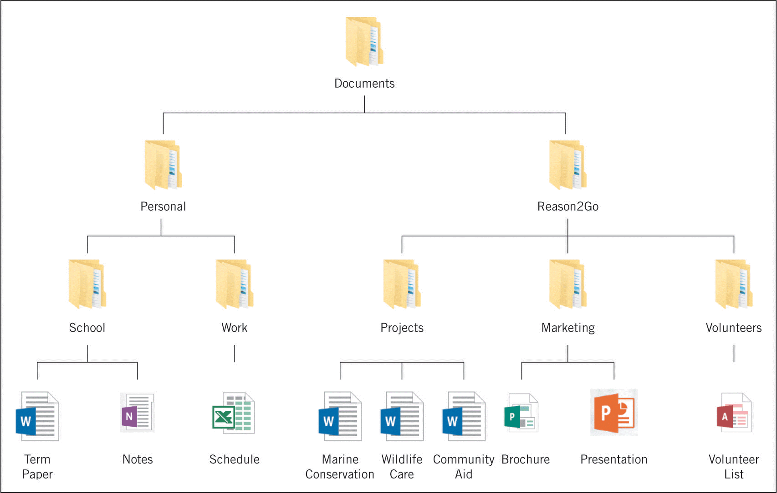
Understand Files and Folders (Slide 2 of 3)

Slide 5
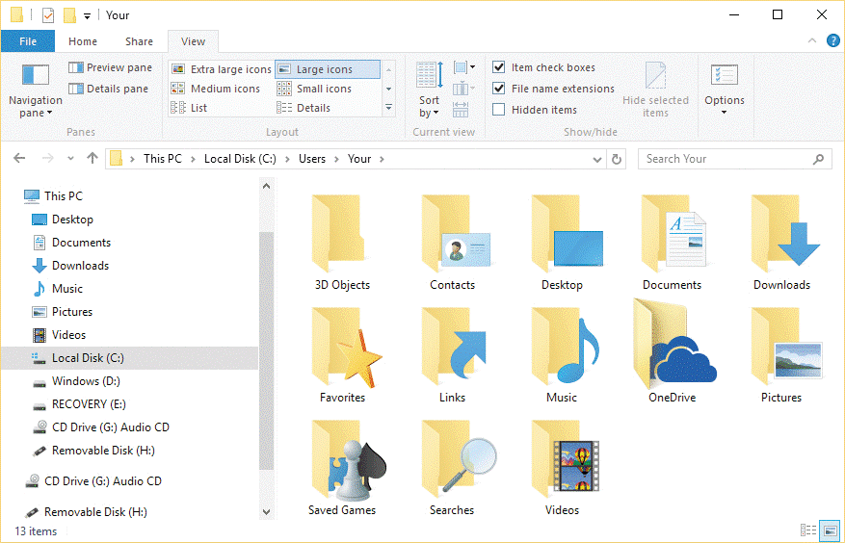
Understand Files and Folders (Slide 3 of 3)

Slide 6
Create and Save a File (Slide 1 of 3)
Any document you create with a program is temporarily stored in RAM (random access memory)
If the power fails, then everything in RAM is lost
You must save your document to a disk, either before you exit the program or periodically while you use the program
  Storage devices include hard disks, online storage locations, and USB flash drives

Slide 7
Create and Save a File (Slide 2 of 3)
The app you are using will add a file extension at the end of the filename you provide
The file extension identifies the type of file, for example, a document file, a video file, or a music file
The file extension is a three- or four-letter sequence, preceded by a period

Slide 8
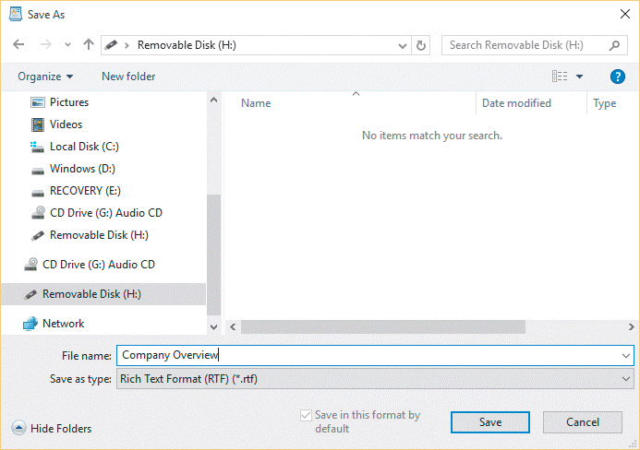
Create and Save a File (Slide 3 of 3)
Save As dialog box

Slide 9
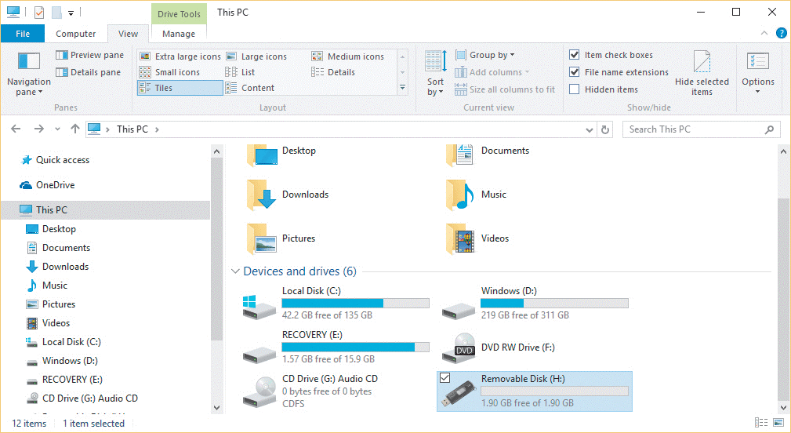
Explore the Files and Folders on Your Computer (Slide 1 of 2)
In a File Explorer window, you can navigate through your computer contents using the File list, the Address bar, and the Navigation pane
  Click This PC to show storage locations on your computer

Slide 10
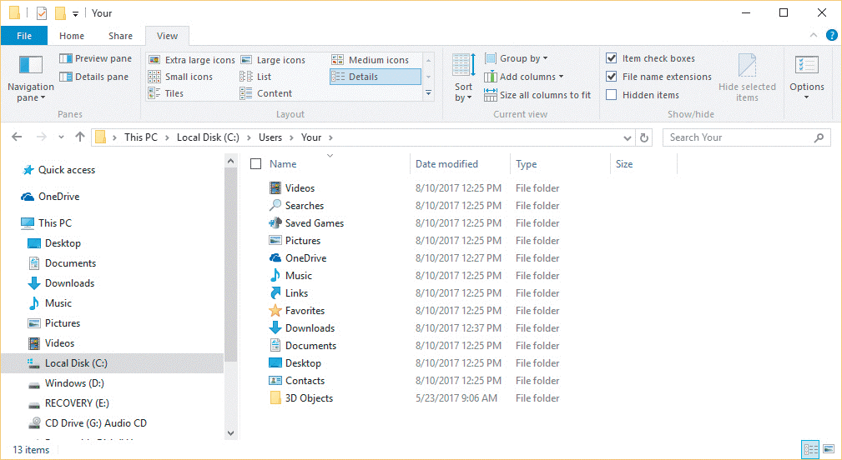
Explore the Files and Folders on Your Computer (Slide 2 of 2)
Your user name folder

Slide 11

Change File and Folder Views (Slide 1 of 2)
You can customize your view, which is a set of appearance choices for files and folders
  Eight different layouts
The Sort by button lets you sort, or reorder your files and folders according to several criteria
Layout options

Slide 12
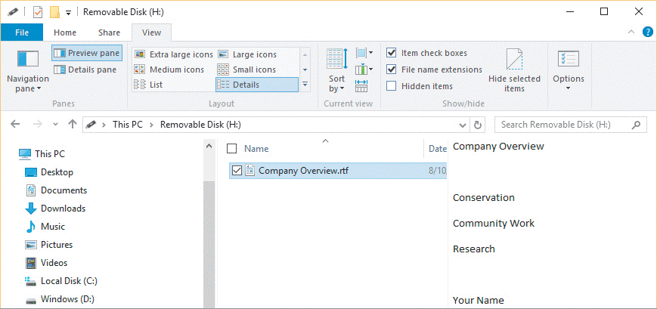
Change File and Folder Views (Slide 2 of 2)
Preview pane allows you to preview a file without opening it

Slide 13
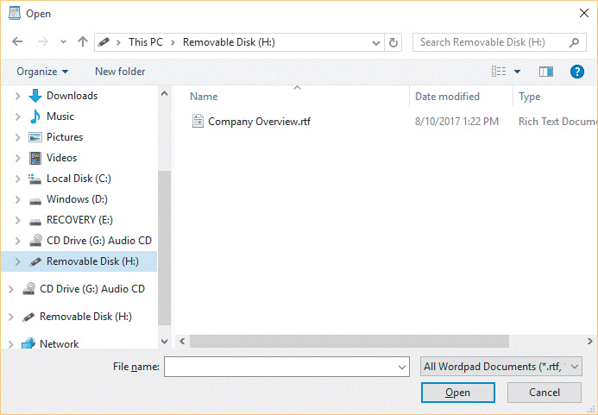
Open, Edit, and Save Files
Once you have created a file and saved it with a name in a folder on a storage device, you can easily open it and edit it

Slide 14
Copy Files (Slide 1 of 4)
When you use the Copy command, Windows 10 places a duplicate copy of the file on the clipboard
When you copy a file, the original file stays in its current location and you have a duplicate copy of the same file in another location

Slide 15
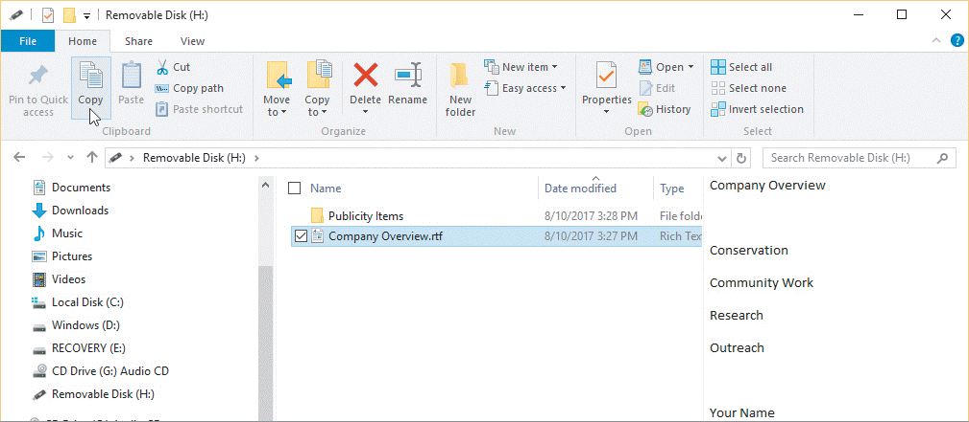
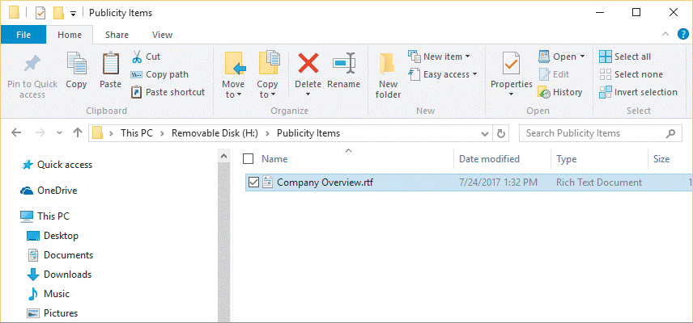
Copy Files (Slide 2 of 3)
Copying a file
Duplicate file pasted to different location

Slide 16
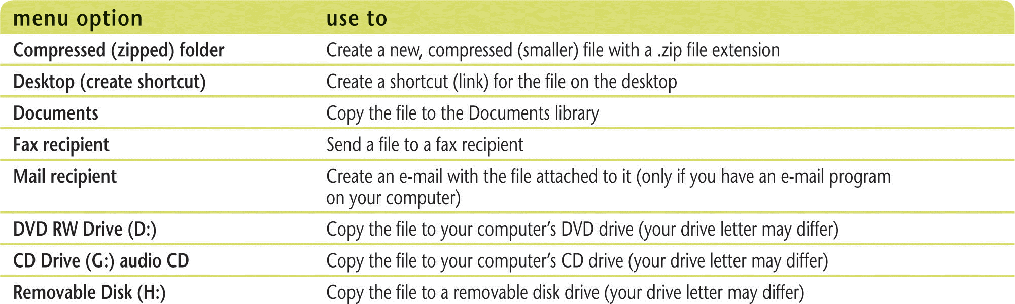
Copy Files (Slide 3 of 3)
Can copy and paste with Send to command

Slide 17
Move and Rename Files (Slide 1 of 3)
Can move one of more files or folders
  When you move a file, the file is transferred to the new location and no longer exists in its original location
Can move a file using the Cut and Paste commands
Can rename files to make the names more descriptive or accurate

Slide 18
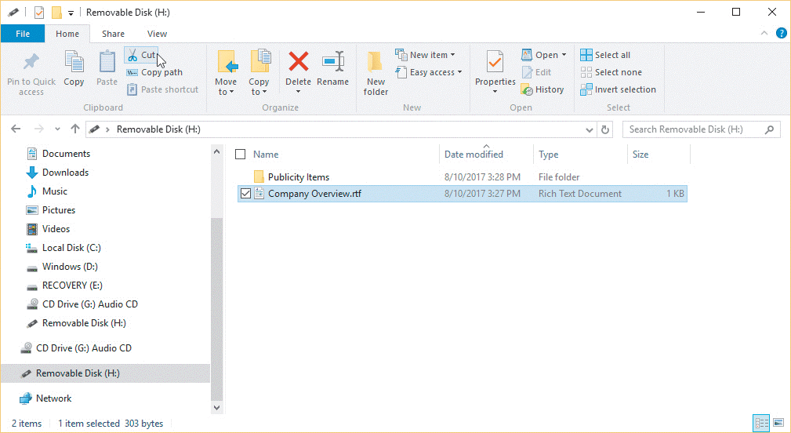
Move and Rename Files (Slide 2 of 3)
Cut a file

Slide 19
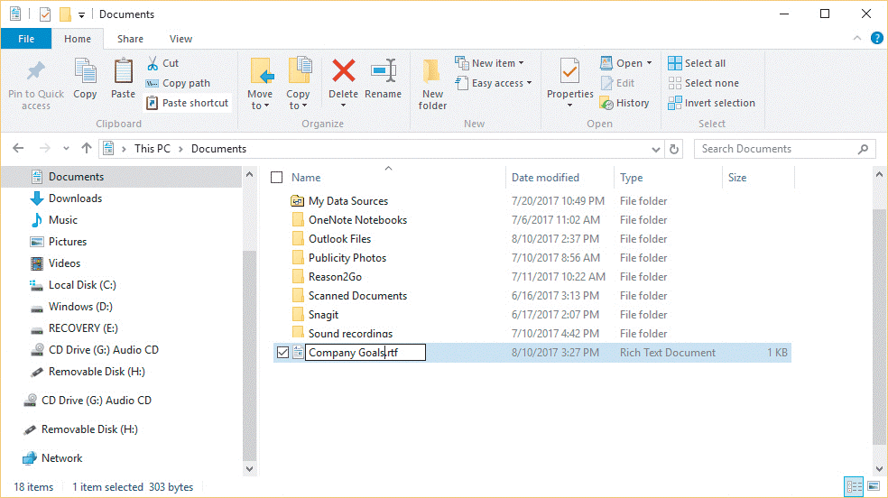
Move and Rename Files (Slide 3 of 3)
Rename a file

Slide 20
Search for Files and Folders (Slide 1 of 2)
Windows Search helps you quickly find any program, folder, or file
The search text you type is called the search criteria
  Search criteria can be a filename, part of a filename, or any other text
This PC box in the Navigation pane limits retrieval to only files and folders on your computer and storage locations

Slide 21
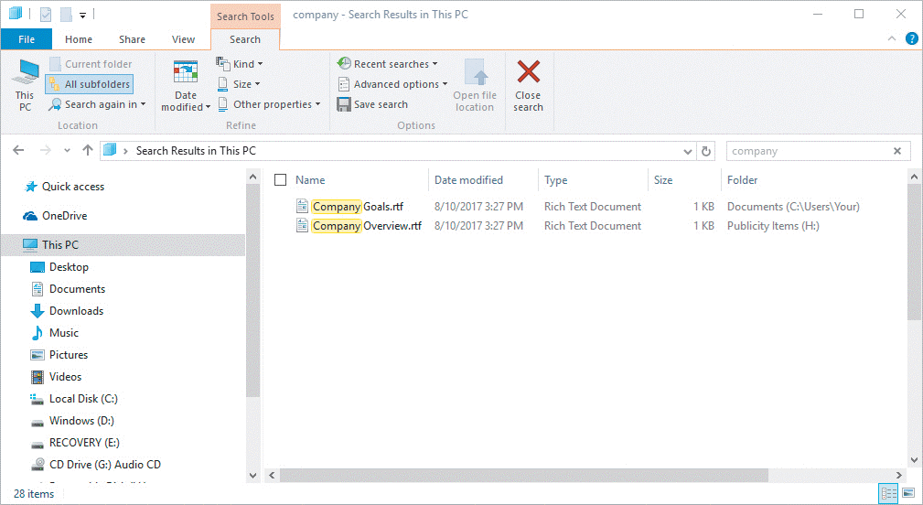
Search for Files and Folders (Slide 2 of 2)
Apps screen and Search pane

Slide 22
Delete and Restore Files (Slide 1 of 5)
If you no longer need a folder or file, you can delete it from the storage device
By regularly deleting files and folders you no longer need and emptying the Recycle Bin, you free up valuable storage space on your computer
Windows 10 places files and folders you delete in the Recycle Bin
If you delete a folder, Windows 10 removes the folder as well as all files and subfolders stored in it

Slide 23
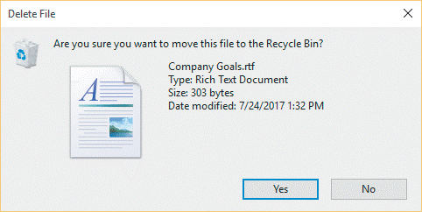
Delete and Restore Files (Slide 2 of 5)
Delete File dialog box

Slide 24
Delete and Restore Files (Slide 3 of 5)
If you later discover that you need a deleted file or folder, you can restore it to its original location, but only if you have not yet emptied the Recycle Bin
Emptying the Recycle Bin permanently removes the deleted folders and files from your computer
Files and folders you delete from a removable storage drive do not go to the Recycle Bin; they are immediately and permanently deleted and cannot be restored

Slide 25
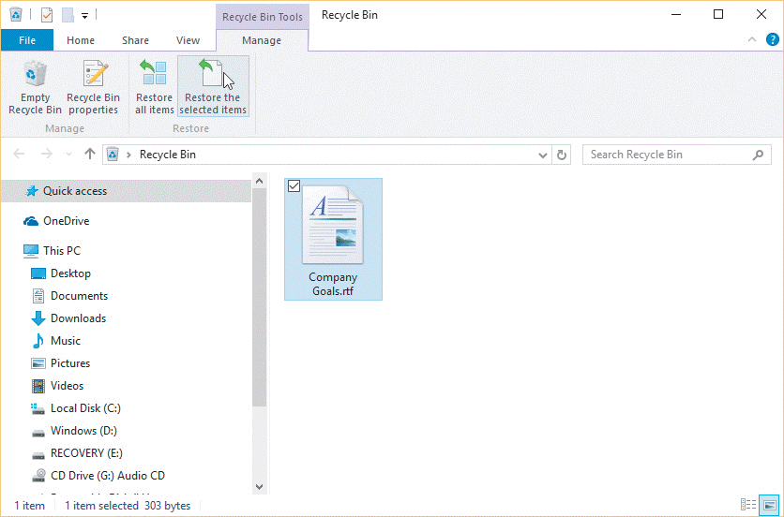
Delete and Restore Files (Slide 4 of 5)
Restoring a file from Recycle Bin

Slide 26
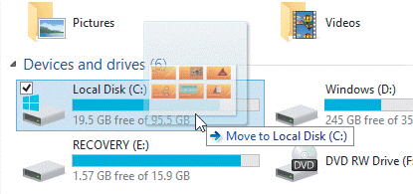
Delete and Restore Files (Slide 4 of 5)
Drag and drop (use pointing device to drag a file or folder to a different location)
  If you drag and drop a file or folder to a different drive, Windows copies it
  If you drag and drop a file or folder to the same drive, Windows moves it

